Slide 1
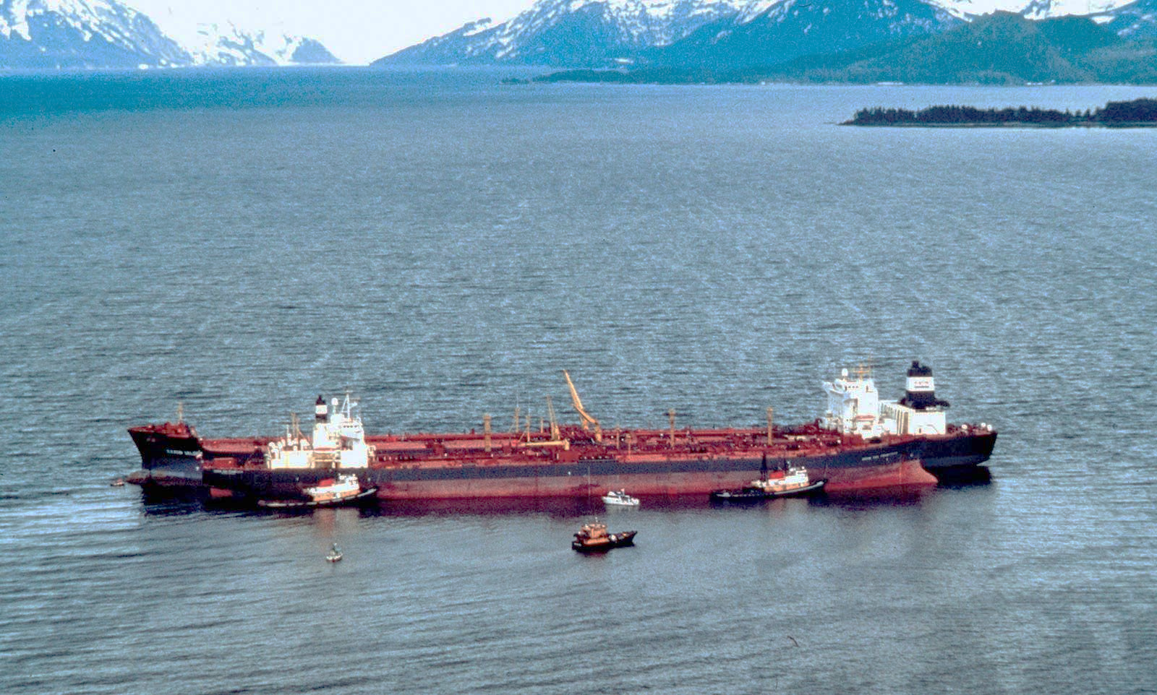
Exxon Valdez Oil Spill: An Environmental Disaster
Corporate Negligence, Ecological Devastation & Lessons
2025/6/3
Notes:
Exxon Valdez oil spill | Response, Animals, & Facts | Britannica

Slide 2
Introduction/Background
Key Facts:
• March 24, 1989: Exxon Valdez supertanker strikes Bligh Reef
• 11 million gallons spilled (≈125 Olympic swimming pools)
• Contaminated 1,300+ miles of Alaskan coastline
• Largest U.S. spill until Deepwater Horizon (2010)
Immediate Consequences:
• 4,000 km² oil slick within 72 hours
• Decades-long ecological crisis
Notes:
SPEAKER NOTES:
- Emphasize scale: Equivalent to emptying 125 Olympic swimming pools of crude oil
- Show timeline: 1989-1992 key events
VISUAL: Aerial photo of oil slick

Slide 3
Location: Prince William Sound, Alaska
Ecological Significance:
• Critical habitat for salmon, orcas, seabirds, sea otters
• Home to Chugach Indigenous communities
Geographic Vulnerability:
• Cold water slows natural oil degradation
• Fjords trap oil in sediments
Long-term Contamination:
• 25,000+ gallons remained after 20 years
• Toxins still detectable today
Notes:
SPEAKER NOTES:
- Highlight biodiversity: 200+ species impacted
- Explain why cold environments are particularly vulnerable to oil persistence
VISUAL: Map highlighting spill zone + ecosystem hotspots

Slide 4
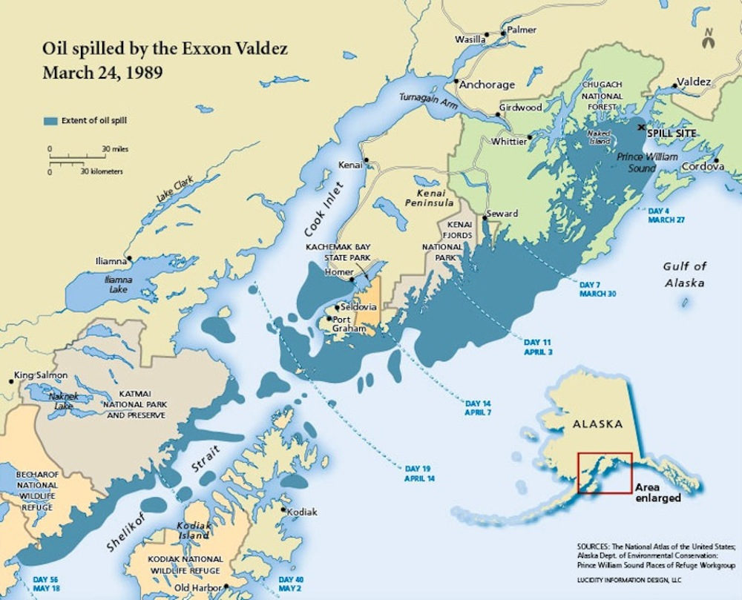
Location: Prince William Sound, Alaska
Notes:
SPEAKER NOTES:
- Highlight biodiversity: 200+ species impacted
- Explain why cold environments are particularly vulnerable to oil persistence
VISUAL: Map highlighting spill zone + ecosystem hotspots

Slide 5
Source/Cause of the Problem
Direct Causes:
• Intoxicated captain asleep below deck
• Untrained third mate navigating
• Radar broken for 1+ year (cost-cutting measure)
Systemic Failures:
• Fraudulent spill-response plans:
- 'Ghost teams' (non-existent responders)
- Falsified equipment logs
• Regulatory failures:
- Ignored 1971 safety pledges to Indigenous communities
Notes:
SPEAKER NOTES:
- Emphasize corporate negligence over individual blame
- Mention Exxon saved $22,000/year by not repairing radar
VISUAL: Infographic showing human/system failure chain

Slide 6
Impact on Environment
Immediate Devastation:
• 250,000 seabirds killed
• 2,800 sea otters perished
• 300 seals dead
Long-term Consequences:
• Oil persists in sediments (>30 years)
• Trophic cascade:
Otter decline → Urchin explosion → Kelp forest collapse
• Indigenous communities:
1/3 fishermen died before receiving compensation
Notes:
SPEAKER NOTES:
- Quantify impacts: 28% of otters, 9% of birds in area killed
- Mention PAH concentrations caused 80% amphipod mortality
VISUAL: Side-by-side wildlife photos (oiled vs healthy)

Slide 7
Management Strategy
Failed Methods | Effective Solutions | Policy Response
❌ Toxic dispersants (Corexit) ❌ High-pressure hot washing ❌ 'Cleanup complete' fraud | ✅ Bioremediation (5× degradation) ✅ Nutrient optimization ✅ Plant-based surfactants | Oil Pollution Act (1990): - Double-hull tankers - Spill liability funds - Response planning
Notes:
SPEAKER NOTES:
- Corexit toxicity: Killed organisms faster than oil
- Bioremediation: Nitrogen optimization at 1-2 mg/L
- Legal outcome: $5B → $500M settlement
VISUAL: Comparison table with icons

Slide 8
Conclusion & Legacy
Unlearned Lessons:
• 80% of Alaskan oil infrastructure remains aging
• Arctic drilling expands despite risks
Path Forward:
• Prioritize non-toxic cleanup tech:
- Bio-aerogels, plant-based surfactants
• Empower Indigenous-led monitoring
• Enforce corporate accountability
"The spill was not an accident but a corporate crime" - G. Palast (2008)
Notes:
SPEAKER NOTES:
- Highlight current risks: 23 aging tankers still in Alaskan waters
- Mention promising tech: Nanocellulose aerogels absorb 50x weight in oil
- Call to action: Support Indigenous conservation initiatives

Slide 9
Reference
Exxon Valdez Oil Spill Trustee Council. (2020). 30 years later: Status of resources injured by the Exxon Valdez oil spill. Anchorage, AK.
https://evostc.state.ak.us/reports/30-year-synthesis-report/
Peterson, C. H., Rice, S. D., Short, J. W., Esler, D., Bodkin, J. L., Ballachey, B. E., & Irons, D. B. (2003). Long-term ecosystem response to the Exxon Valdez oil spill. Science, *302*(5653), 2082–2086.
National Oceanic and Atmospheric Administration (NOAA). (2019). Exxon Valdez oil spill restoration: 30 years of science. Silver Spring, MD.
https://darrp.noaa.gov/oil-spills/exxon-valdez
Exxon-Valdez oil spill: Britannica https://www.britannica.com/event/Exxon-Valdez-oil-spill
Notes:
SPEAKER NOTES:
- Highlight current risks: 23 aging tankers still in Alaskan waters
- Mention promising tech: Nanocellulose aerogels absorb 50x weight in oil
- Call to action: Support Indigenous conservation initiatives

